Slide 1
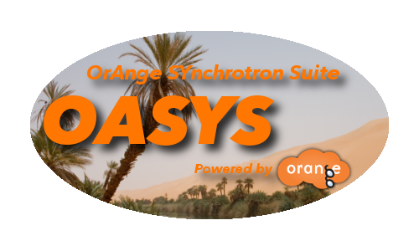
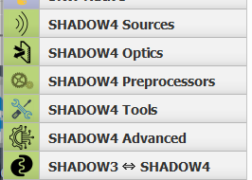
Introduction to SHADOW 4
Manuel Sanchez del Rio
srio@esrf.eu
Advanced Analysis & Precision Unit, MEG/ISDD, ESRF
SHADOW4

Slide 2
Outline
Generalities
Software
SHADOW history
How it works?
Python API
Internals: optical surfaces, physical optics
Sources: geometrical, synchrotron
Reference frame and continuation planes
Components: mirrors, monochromators (gratings, crystals and multilayers)
X-ray lenses
External surfaces
Example

Slide 3
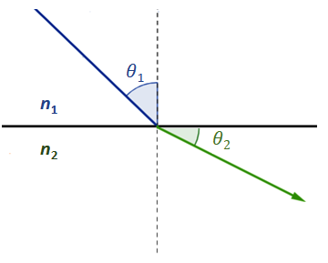
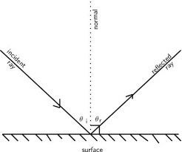
Ray Tracing and Geometrical Optics
Ray tracing in X-ray optics is a simulation method used to model how X-rays travel through and interact with optical components, like mirrors, lenses, and monochromators. It's essential for designing and optimizing beamlines at synchrotrons and other X-ray facilities.
Applications:
Determine beam shape, size, divergence, and focal spot.
Optimize optical alignment and component positioning.
Diagnose aberrations or misalignments.
Limitations:
Pure ray tracing doesn’t account for coherence, diffraction, or interference—those need wavefront propagation or hybrid methods.

Slide 4
X-ray Tracing Software
SHADOW: https://github.com/oasys-kit/shadow4
XRT: https://github.com/kklmn/xrt
McXtrace: https://www.mcxtrace.org

Slide 5
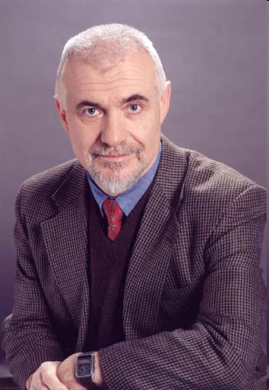
Birth of Shadow (~1980)
Scientific motivation: Grating monochromator design, TGM, toroidal, spherical mirrors.
Monte Carlo ray tracing program designed to simulate X-ray optical systems
Requirements
Accuracy and reliability
Easy to use
Flexibility
Economy of computer resources
VAX-11 Computers
Efficient MC approach
Reduced number of rays
Exact simulation of SR sources
Vector calculus
Modular
User-interface
Available to users
Two years development
Fortran 77+VAX/VMS extensions
Franco Cerrina
(♰2010)

Slide 6
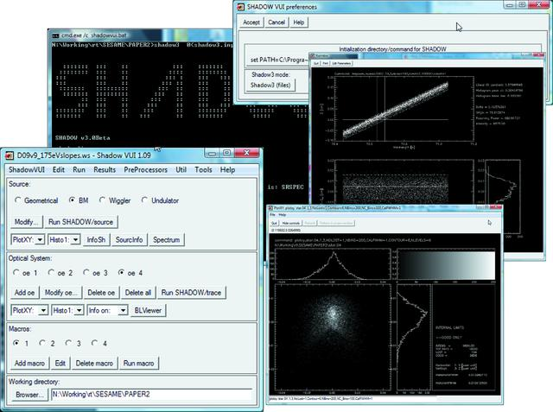
Shadow 3 (2010)
https://github.com/oasys-kit/shadow3
Python3 API
M. Sanchez del Rio, N. Canestrari, F. Jiang and F. Cerrina "SHADOW3: a new version of the synchrotron X-ray optics modelling package" Journal of Synchrotron Radiation Volume 18, Part 5 (September 2011) http://dx.doi.org/10.1107/S0909049511026306

Slide 7
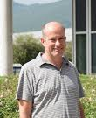

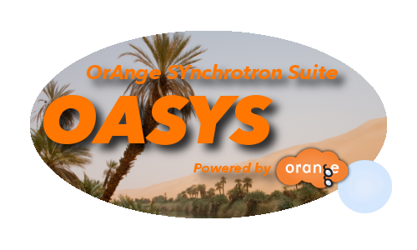
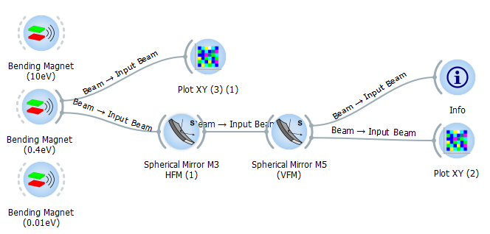
OASYS – ShadowOui (2014)
Manuel
Sanchez Del Rio
Luca Rebuffi
OASYS + Shadow3

Slide 8
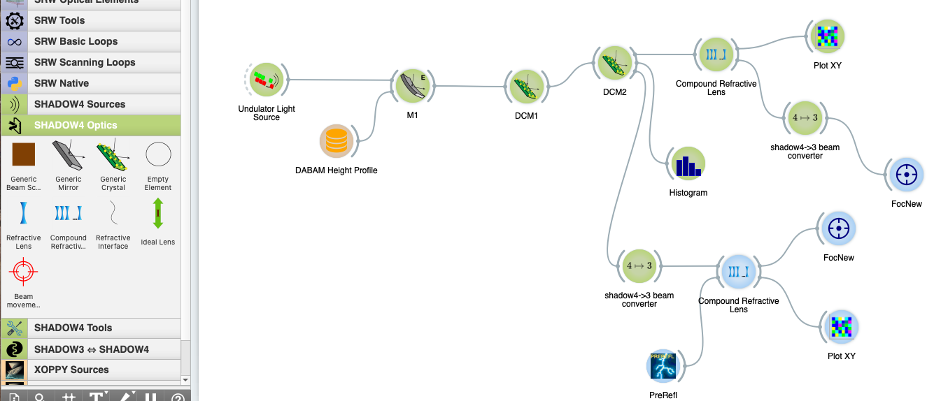
OASYS – Shadow4 (2024)
Fully developed in Python
100% Based on SYNED
Simplified and Optimized GUI
No Pre-Processor Files
S.I. units
Standalone Shadow4 API
+
OASYS-SHADOW4 AddOn
𝜷 release in 2023 – Full release in 2024

Slide 9
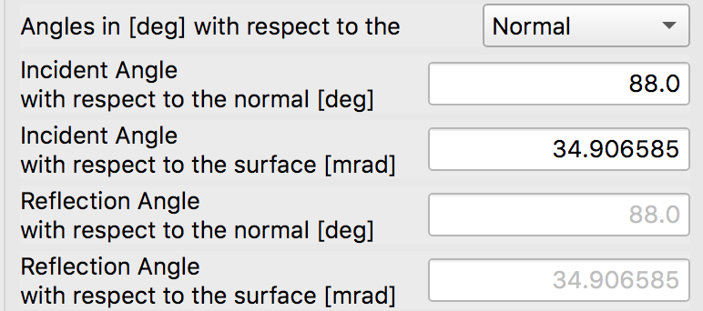
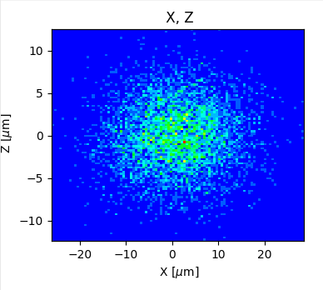
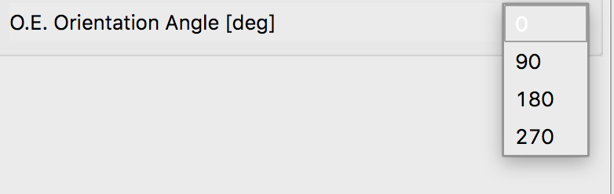
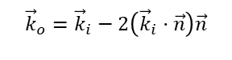
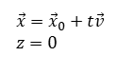
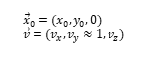
RAY TRACING (SCHEMATIC)
z
$${\vec{x}}_{0}=(x_{0},y_{0},0) \\ \vec{v}=(v_{x},v_{y}≈1,v_{z})$$
$${\vec{k}}_{o}={\vec{k}}_{i}−2\left({\vec{k}}_{i}⋅\vec{n}\right)\vec{n}$$
Energy, Intensity
y
x
z
z
p
q
x
$$\vec{x}={\vec{x}}_{0}+t\vec{v} \\ z=0$$
y
x

Slide 10
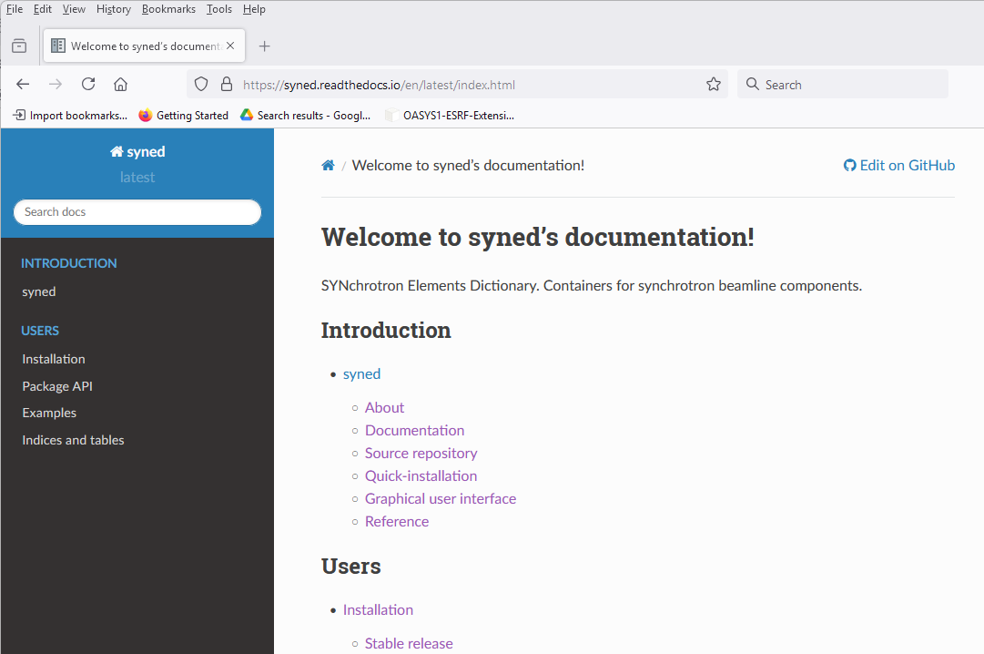
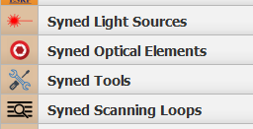
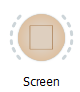
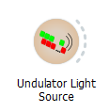
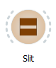
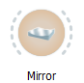
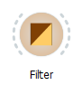
SynED concept (Synchrotron Element Dictionary) https://github.com/oasys-kit/syned
detectors
monochromators
sources
mirrors
slits
filters
Shadow initial beam is generated by a Source element

Slide 11
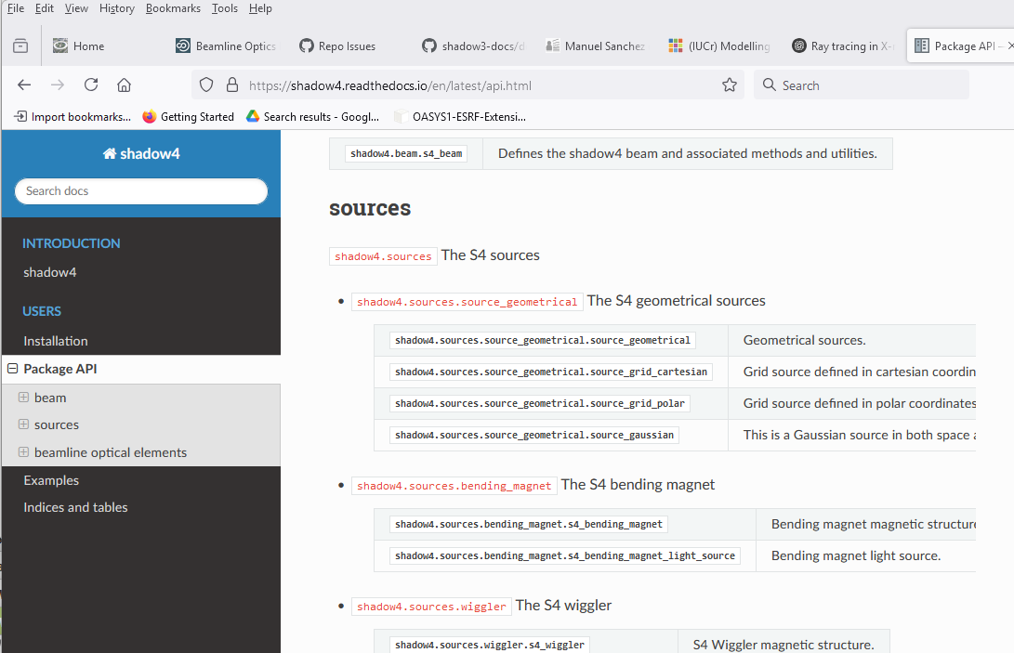
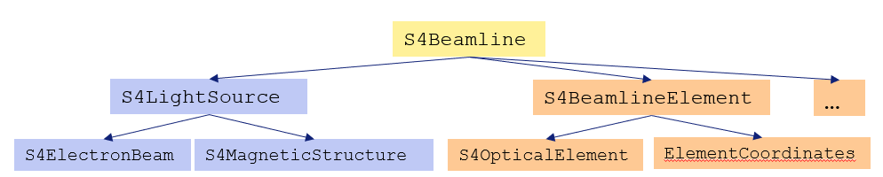
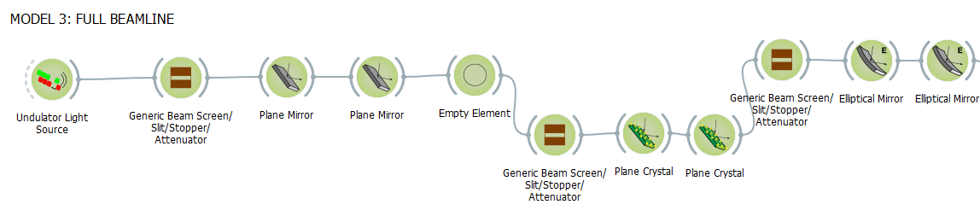
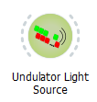
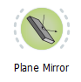
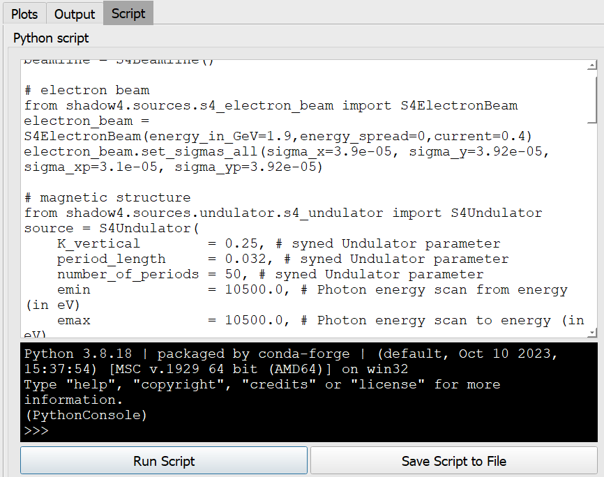
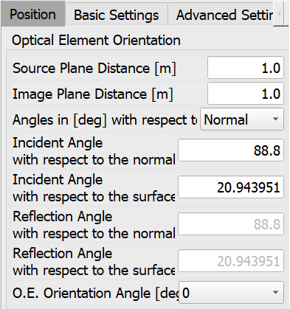
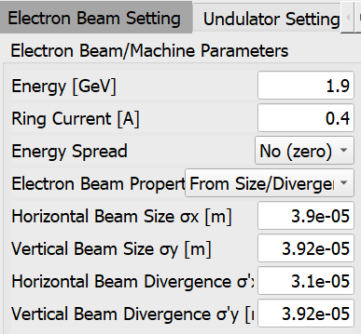
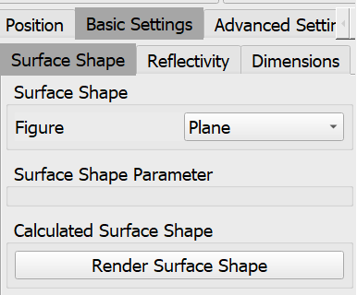
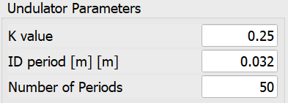
Shadow4: python package (kernel) + Interface (OASYS add-on) https://github.com/oasys-kit/shadow4
User API
User Interface

Slide 12
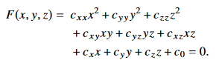
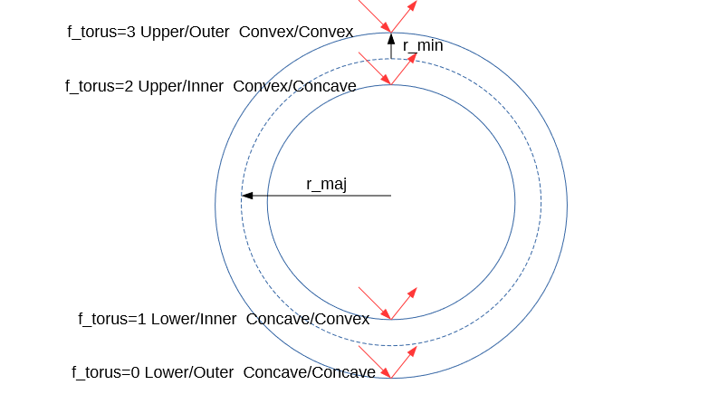
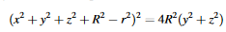
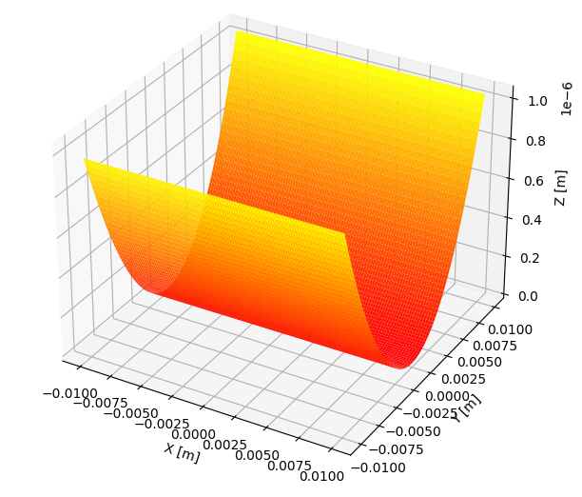
Shadow4: Three Optical surfaces (geometrical model)
The operations of intersection ray-optical element are performed by a class family S4OpticalSurface.
They contain the methods to compute how a ray is reflected (by mirrors), refracted (by lenses) or scattered (by gratings)
The subclasses, that implement the traditional surfaces in SHADOW, are
S4Conic, for conic surfaces (planes, spheres, ellipsoids, hyperboloids, paraboloids and cylindrical ones) https://doi.org/10.48550/arXiv.2406.04079
S4Toroid, a toroid (4th-degree equation)
S4Mesh, a generic surface numerically defined over a regular mesh.

Slide 13
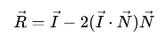
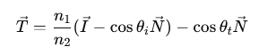
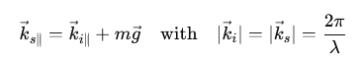
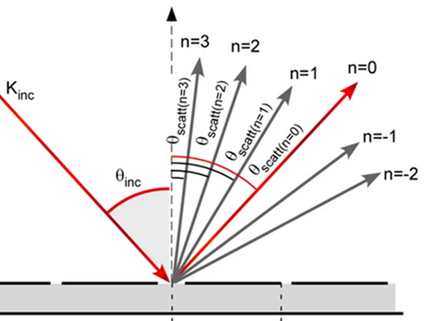
Shadow4: Three Optical surfaces
The class family S4OpticalSurface contain the methods to compute how a ray is reflected (by mirrors), refracted (by lenses) or scattered (by gratings)
Reflection Refraction Scattering
(specular) Vector Equation (Using Snell's Law) Vector grating equations

Slide 14
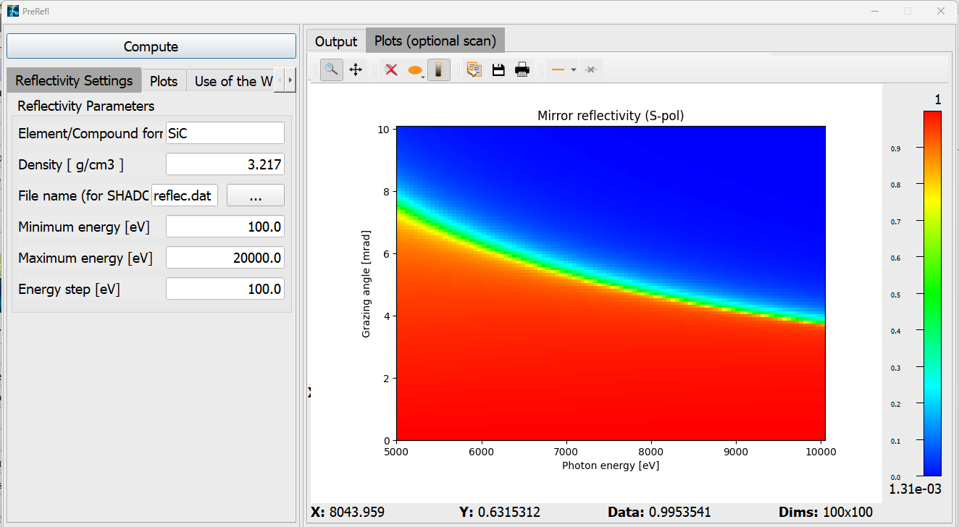
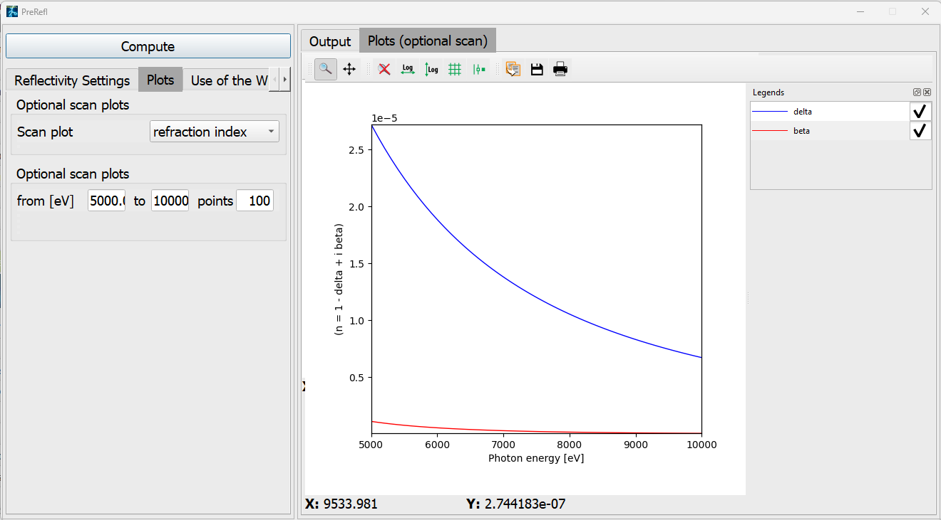
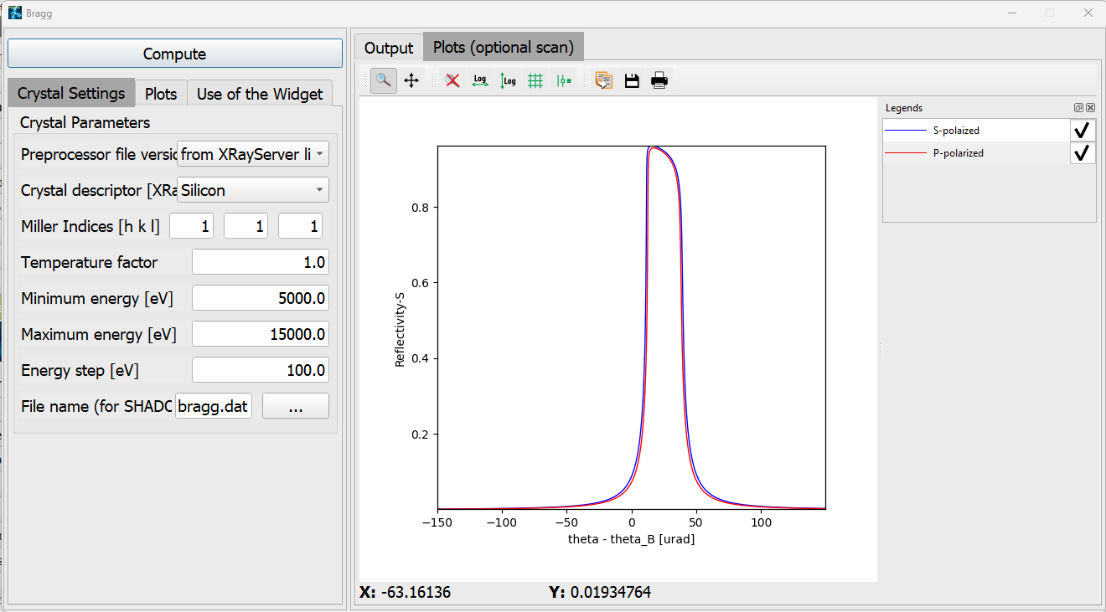
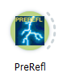
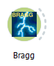
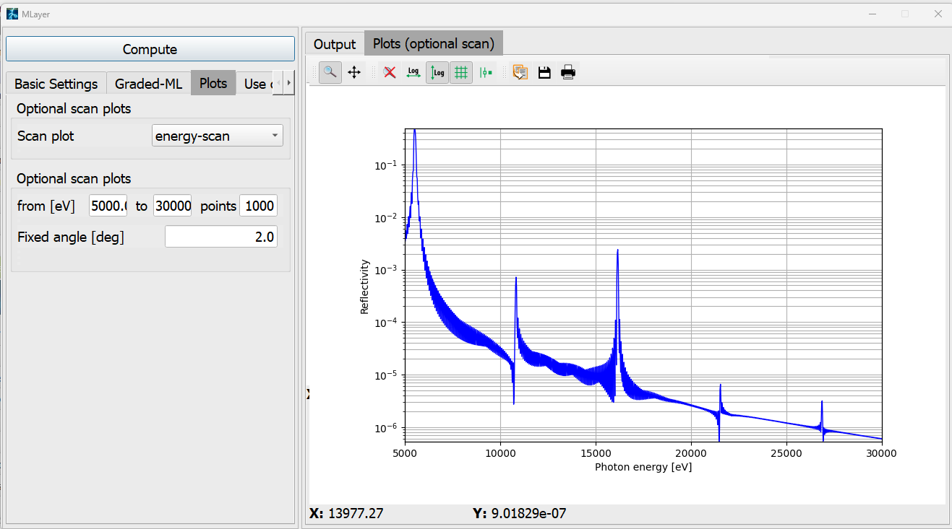
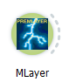
Shadow4: computing reflectivity (the physical model)
Traditionaly included via a “preprocessor” file. It is still used but the reflectivities can be calculated on-the-fly (without preprocessor file)
Reflection (mirrors and multilayers) Refraction (Lenses) Scattering (gratings) Scattering (crystals)
Fresnel equations PreRefl
Parratt equations MLayer n and mu PreRefl No grating efficiency! crystalpy¹
¹⁾
https://github.com/oasys-kit/crystalpy
http://dx.doi.org/10.1107/S160057752400924X

Slide 15
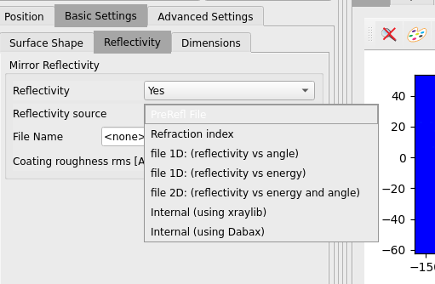
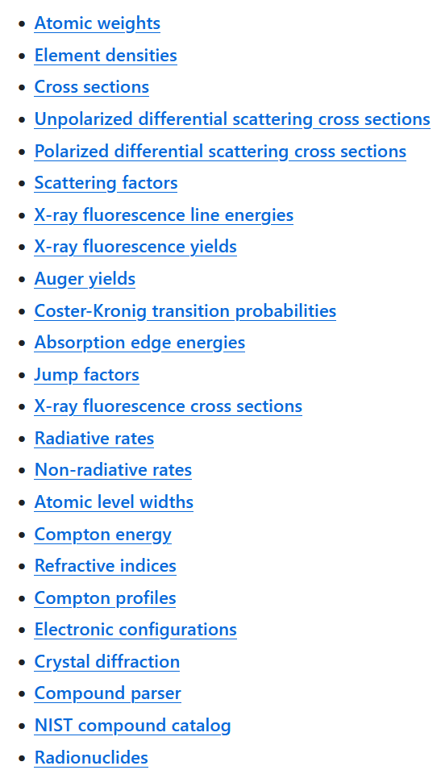

Shadow4: photon-material interaction databases
None (preprocessor file)
Xraylib: https://github.com/tschoonj/xraylib
Dabax: https://github.com/oasys-kit/dabax
Xraylib Dabax
(families) (files)

Slide 16






Shadow4: Geometrical Sources
In cartesian coordinates
In polar coordinates

Slide 17




Shadow4: Bending Magnets
SHADOW3 SHADOW4
https://doi.org/10.48550/arXiv.2406.16446

Slide 18





Shadow4: Wigglers (and short IDs)
ALS 3 bending magnets for IR radiation ESRF BM18 Triple Pole Wiggler and adjacent BMs

Slide 19





Shadow4: Gaussian Undulator (on-resonance!!)
Fake Geometrical Source
(Gaussian spatial + Gaussian divergency + e- energy spread)

Slide 20





Shadow4: Undulator Light Source (Full undulator)
Highly improved!
Spectrum calculation
3 models (internal, pySRU, SRW)
For far field (very good agreement)
For backpropagation (diffraction-limited size): “tricky”
Monochromatic source (also including e- energy dispersion)
Polychromatic source
Reference: https://doi.org/10.1107/S1600577525000190
789.938eV
806.060eV
814.121eV

Slide 21






Shadow4: Electric Field Management
Redundancy:
Polarization degree:

Slide 22

Shadow4: References and continuation planes
Optical axis
Image Plane for O.E.1
Source Plane for O.E.2
Source Plane for O.E.1
O.E.1
O.E.2
Note that (VERY IMPORTANT!):
The y (column 2) coordinate is along the beam direction
The position (Source Plane Distance), orientation (O.E. Orientation Angle) of any o.e. is always referred to the previous one
Source Plane and Image Plane for each optical element are the “Continuation Planes”
The frame is rotated if one o.e. is rotated

Slide 23

Shadow4: The “alpha” (O.E orientation angle)

Slide 24





Shadow4: Mirrors
R
p
q
Functions
•Beam deflection
•Power filter (removed high energy photons: low-pass filter)
•Spectral shaper (high harmonic rejection)
•Collimation or focusing – use of curved surfaces
Old times: wiggler & bending magnet : spherical, cylindrical, and toroidal mirrors
New times:
source demagnification (ellipsoidal mirror, Kirkpatrick-Baez mirrors)
imaging (Advanced KB mirrors)
Limitations
shape errors (manufacturing and thermal and mechanical deformations)
slope and height errors (waviness)
height roughness
ρ
M = p/q
Same angle, different coatings
Same material, different angles

Slide 25








Shadow4: Monochromators
Grating (dispersion) + Slit (window)
Combined with focusing by
Curved surfaces
VLS: Varying Line Spacing
Only reflection
No efficiency calculation
Non-dispersive (Bragg-symmetric)
Dispersive (Asymmetric)
Combined with focusing by
Curved surfaces
Includes energy/angle window (Darwin width)
Dynamical theory (perfect crystals)
Long list of crystals (any structure available)
Only reflection (Bragg). No Laue (to be done)
Reflectivity for undistorted crystals
(external for symmetric)
No mosaic (to be done)
No Johansson (to be done)
Combined with focusing by curved surfaces
Graded (Depth and/or Laterally)
Only reflection (no ML lens)
No tri-layers (only bilayers)

Slide 26







Shadow4: X-ray Lenses
All interfaces individually traced
Absorption
Many Curved surfaces (parabolic etc)
VLS: Varying Line Spacing
Chromatic aberrations naturally included
“Length” aberration (adiabatic) naturally included
1D and 2D
No errors (only for interface)
No block movements
Slow (for many lenses)
Single interface
Lens
CRL (Compound Refractive Lens)
Transfocator
Approximately:
First Experimental demonstration of CRL: A. Snigirev et al Nature 384 (1996) 49

Slide 27








Shadow4: Surface Errors/Deformations
Common OASYS format: and tools:
Direct Link
Measured profiles
(DABAM)
Surface Errors
(Height Profile
Simulator)
From custom 1D profiles
(Pre-DABAM)
From FEA files
(currently at ESRF add-on)

Slide 28


Shadow4: Example
Optical components that could be present in a beamline:
Monochromator
Double crystal
Si 111
Focusing system
Front end
Primary slits
Sample
KB mirrors
Source
U42 @ 5keV
Primary mirrors
Plane Ni 7 mrad
KB slits
27.2 m
51 m
51.5 m
51.59 m
51.65 m

Slide 29




Full beamline (MODEL 3)
SIZE RESOLUTION FLUX
0.6 eV
---> Integrated Flux : 1.21e+13 ph/s

Slide 30
Shadow4: Advanced Features
L. Rebuffi & X. Shi
Hybrid Method
Loops for:
Optical Specifications
Thermal Load
Specific
Thickness Error Profiles for Refractive Elements
Bendable Mirrors

Slide 31
Additional slides

Slide 32

DABAM: DAta BAse for x-ray mirror Metrology
Motivation:
The best way to simulate the effect of surface errors is using measured data
Automation of: ask, obtain, transform, adapt, convert and simulate…
MEADOW2013: Call for collaboration
17 authors
25 profiles
Data and metadata formats (simple)
Access code (python)
Integration in OASYS (used with shadow, srw, etc.)

Slide 33


96 PROFILES IN DABAM (in SEP 2023)

Slide 34



THE CODE: dabam.py
available in srxraylib:
https://srxraylib.readthedocs.io/en/latest/api.html#metrology
python –m srxraylib.metrology.dabam –h python –m srxraylib.metrology.dabam 13 –P heights

Slide 35








DABAM in Oasys
Retrieve
Scale, adjust and replicate
Export hdf5
For those that want more realistic structures in the sagittal direction:

Slide 36



CALL FOR COLLABORATION: DABAM2D
2D profiles
x-ray lenses
Thin objects
Mirrors
Substrates
Prototype:
Format (h5 Oasys)
Server https://github.com/oasys-esrf-kit/dabam2d
OASYS compatible widgets
Join us!
Submit profiles (e.g., https://github.com/oasys-esrf-kit/dabam2d/issues )
Paper submission (2024)
OASYS WEB

Slide 37

Ray Tracing and Geometrical Optics
Geometrical optics, or ray optics, is a model of optics that describes electromagnetic radiation propagation in terms of rays, that are an abstraction useful for approximating the paths along which light propagates.
Rays propagate in straight-line paths as they travel in a homogeneous medium. They follow the laws of reflection and refraction or are absorbed.
Ray tracing is a method for calculating the path on rays that relies on approximate solutions to Maxwell's equations that are valid as long as the light waves propagate through and around objects whose dimensions are much greater than the light's wavelength. Ray theory does not describe phenomena such as interference and diffraction, which require wave theory.

Slide 38

Ray Tracing, Shadow and ShadowOui
Basic Shadow :
Each optical element has an incident beam, that is located on a plane called Source Plane.
Each Optical Element has the axis system always oriented with Z normal to the optical surface, Y tangent to the surface along the direction of propagation of the beam and X tangent to the surface and normal to Z and Y.
The orientation of the optical surface is given by the angle of rotation 𝜶 along the Y axis and is relative to the axis system of the incident beam, as defined in the source plane.
The beam is traced up to Image Plane, which has the Y axis oriented as the direction of propagation of the beam (that will depend on the particular optics) and Z, X in the same plane of the same axis of the Optical Element.
Source Plane
Image Plane
Optical Element

Slide 39

Shadow4: Mirrors

Slide 40


Shadow4: Gratings
No model (yet) in SHADOW for grating efficiency

Slide 41


Shadow4: Crystals

Slide 42

Shadow4: Multilayers

Slide 43



Shadow4: X-Ray Lenses
p
q

Slide 44
ShadowOui: References
L. Rebuffi, M. Sanchez del Rio, "ShadowOui: A new visual environment for X-ray optics and synchrotron beamline simulations”, J. Synchrotron Rad. 23 (2016). DOI:10.1107/S1600577516013837
​​​​​M. Sanchez del Rio, D. Bianchi, D. Cocco, M. Glass, M. Idir, J. Metz, L. Raimondi, L. Rebuffi, R. Reininger, X. Shi, F. Siewert, S. Spielmann-Jaeggi, P. Takacs, M. Tomasset, T. Tonnessen, A. Vivo and V. Yashchuk, "DABAM: an open-source database of X-ray mirrors metrology", J. Synchrotron Rad. 23 (2016). DOI: 10.1107/S1600577516005014
L. Rebuffi, X. Shi, M. Sanchez del Rio, R. Reininger, "A ray-tracing algorithm for ab initio calculation of thermal load in undulator-based synchrotron beamlines", J. Synchrotron Rad. 27 (2020). DOI: 10.1107/S160057752000778X
​​​​​L. Rebuffi, X. Shi, "Advanced simulation tools in the OASYS suite and their applications to the APS-U optical design", Proc. SPIE 11493, 1149303 (2020)​. DOI: 10.1117/12.256750

